Slide 1


Slide 2
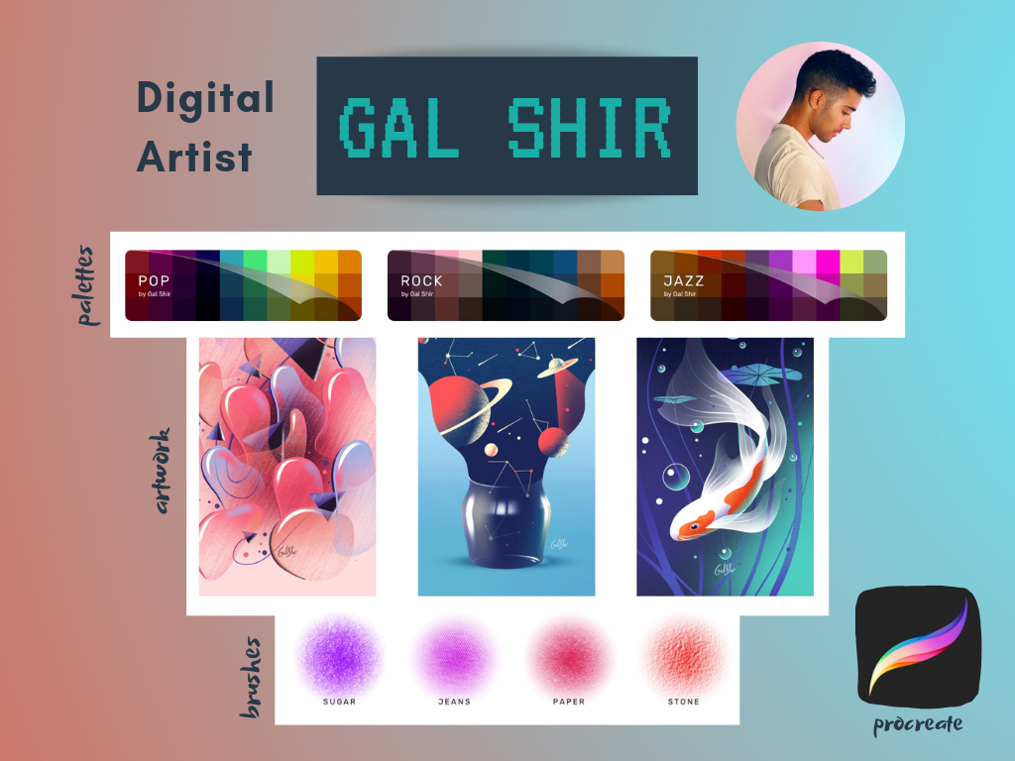
Notes:
https://galshir.com

Slide 3

Notes:
http://stefaniebrueckler.com/#projects

Slide 4

Notes:
https://www.alexcoven.com

